Slide 1
East Midlands
AGM Statistics
04/11/2023

Slide 2
Clubs

Slide 3
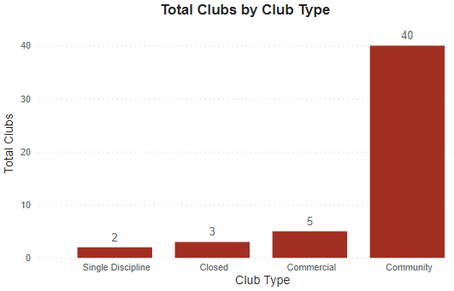
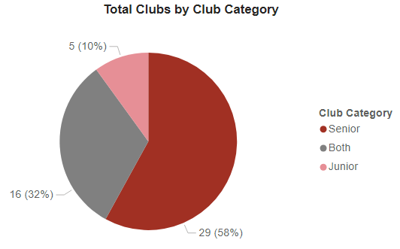
Clubs Overview
50
Total Affiliated Clubs
4053
Total Club Members
81
Average Members per Club

Slide 4
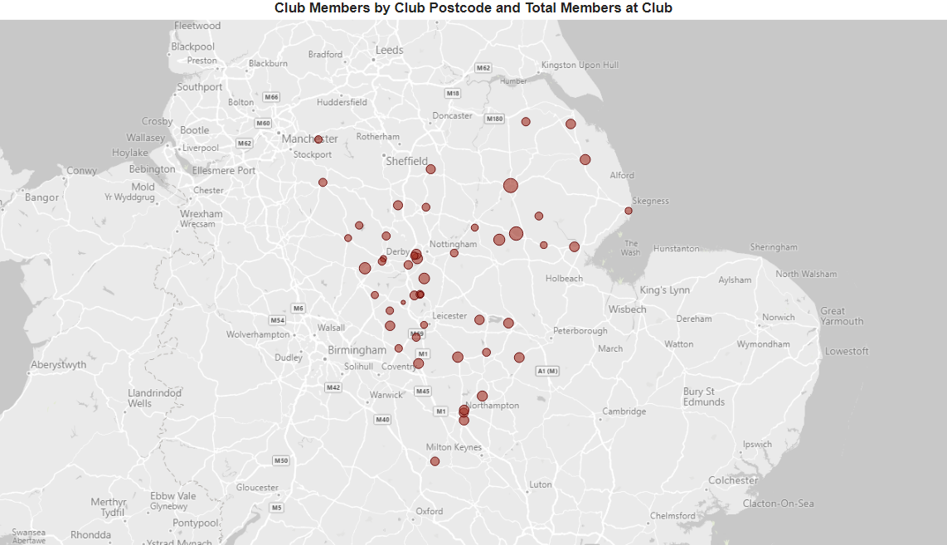
Club Locations

Slide 5
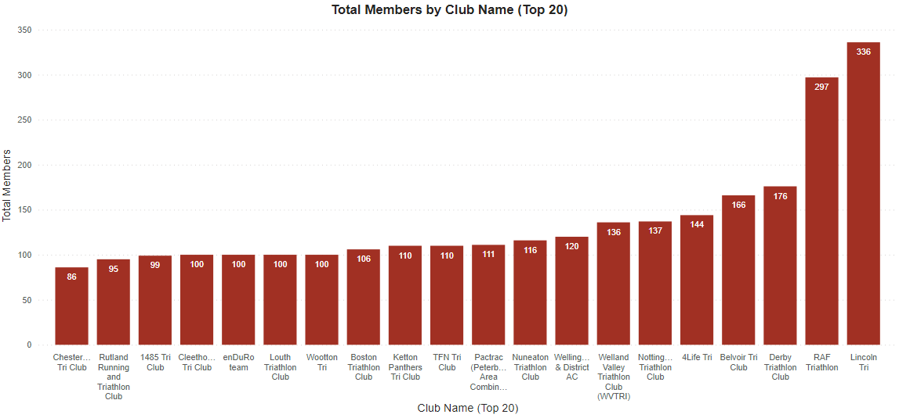
Clubs with Most Members

Slide 6
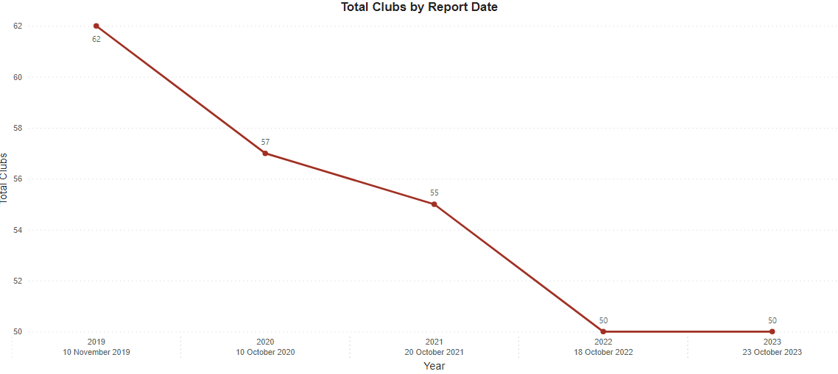
Clubs Over Time

Slide 7
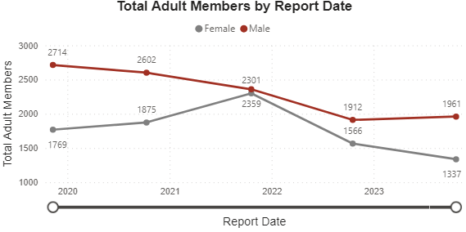
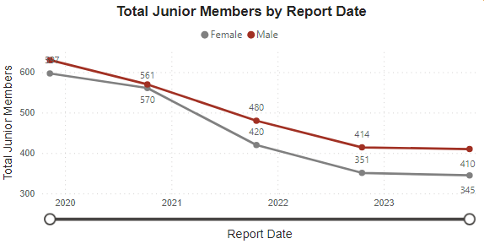
Club Members

Slide 8
Coaching

Slide 9
Coaching Statistics

Slide 10
Thank You
Any Questions?

